Slide 1
Chapter 06_03
Dynamic Programming
Warshall’s (and Floyd’s) Algorithms

Slide 2

Warshall’s and Floyd’s Algorithms for computing
the transitive closure of a directed graph and
the all-pairs shortest-paths problem, respectively.
A B
C
E
D
Let r be the relation of “reachability” or “connectivity”.
Given Q = { A r B, B r C, C r D and D r E}, then
{A r B, B r C, C r D, D r E, A r C, A r D, A r E, B r D, B r E, C r E} is the transitive closure of Q.
The transitive closure of a directed acyclic graph (DAG) is:
the reachability relation of the DAG and a strict partial order.
 | A | B | C | D | E
A | 0 | 1 | 1 | 1 | 1
B | 0 | 0 | 1 | 1 | 1
C | 0 | 0 | 0 | 1 | 1
D | 0 | 0 | 0 | 0 | 1
E | 0 | 0 | 0 | 0 | 0

Slide 3

Warshall’s and Floyd’s Algorithms
They are two well-known algorithms.
Warshall’s computes the transitive closure of a directed graph and
Floyd’s computes the all-pairs shortest-paths problem.
Both algorithms are based on essentially the same idea;
exploit a relationship between a problem and its simpler version, rather than smaller version.
The algorithms are considered to be applications of the dynamic programming technique.

Slide 4
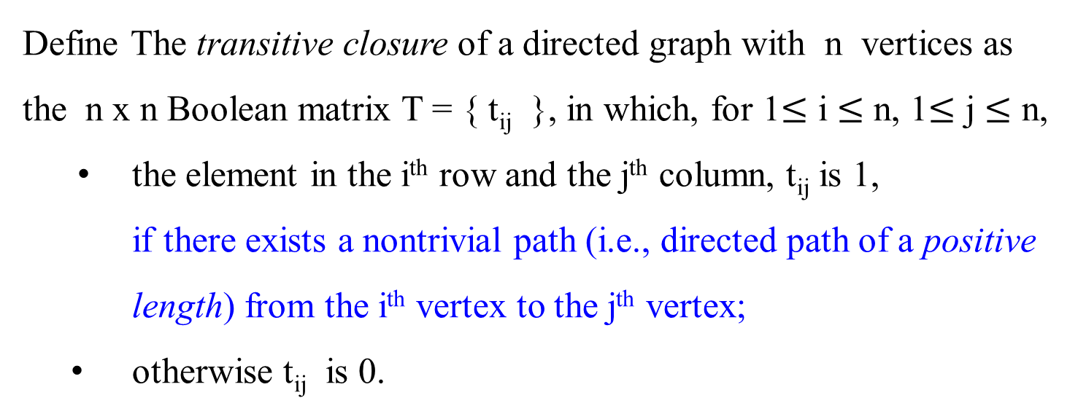
Warshall’s Algorithm
Define The transitive closure of a directed graph with n vertices as
the n x n Boolean matrix T = { t_{ij} }, in which, for 1$≤$ i $≤$ n, 1$≤$ j $≤$ n,
the element in the i^{th} row and the j^{th} column, t_{ij} is 1,
if there exists a nontrivial path (i.e., directed path of a positive length) from the i^{th} vertex to the j^{th} vertex;
otherwise t_{ij} is 0.

Slide 5

Warshall’s Algorithm –
An example: a digraph, and its adjacency matrix, and transitive closure
a
b
 |  |  | a | b | c | d
 |  | a | 1 | 1 | 1 | 1
T | = | b | 1 | 1 | 1 | 1
 |  | c | 0 | 0 | 0 | 0
 |  | d | 1 | 1 | 1 | 1
c
d
Digraph
a b c d
a 0 1 0 0
A = b 0 0 0 1
c 0 0 0 0
d 1 0 1 0
(b) Its adjacency matrix
(c) Its transitive closure
Figure 8.11 (a) Digraph. (b) Its adjacency matrix. (c) Its transitive closure.

Slide 6
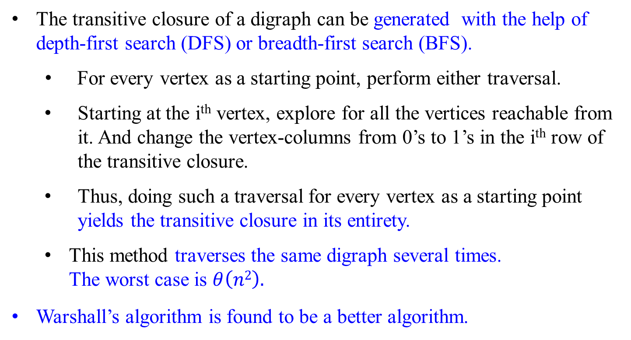
Warshall’s Algorithm
The transitive closure of a digraph can be generated with the help of depth-first search (DFS) or breadth-first search (BFS).
For every vertex as a starting point, perform either traversal.
Starting at the i^{th} vertex, explore for all the vertices reachable from it. And change the vertex-columns from 0’s to 1’s in the i^{th} row of the transitive closure.
Thus, doing such a traversal for every vertex as a starting point yields the transitive closure in its entirety.
This method traverses the same digraph several times. The worst case is $θ\left(n2\right).$
Warshall’s algorithm is found to be a better algorithm.

Slide 7
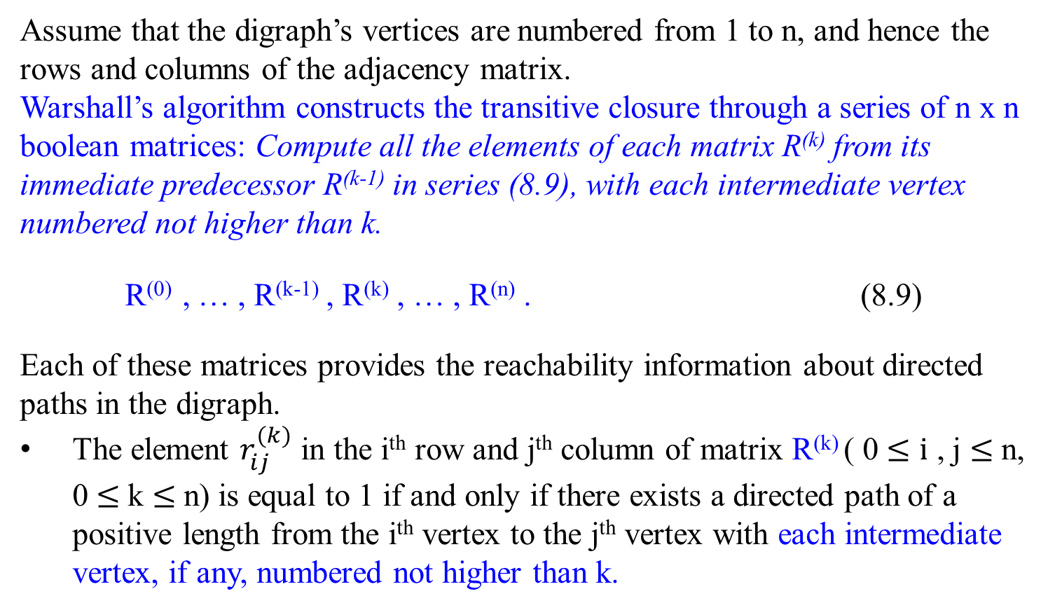
Warshall’s Algorithm
Assume that the digraph’s vertices are numbered from 1 to n, and hence the rows and columns of the adjacency matrix.
Warshall’s algorithm constructs the transitive closure through a series of n x n boolean matrices: Compute all the elements of each matrix R^{(k)} from its immediate predecessor R^{(k-1)} in series (8.9), with each intermediate vertex numbered not higher than k.
R⁽⁰⁾ , … , R^{(k-1)} , R^{(k)} , … , R^{(n)} . (8.9)
Each of these matrices provides the reachability information about directed paths in the digraph.
The element $r_{ij}^{(k)}$ in the i^{th} row and j^{th} column of matrix R^{(k)} ( 0 $≤i$ , j $≤$n, 0 $≤$k $≤$n) is equal to 1 if and only if there exists a directed path of a positive length from the i^{th} vertex to the j^{th} vertex with each intermediate vertex, if any, numbered not higher than k.

Slide 8
Warshall’s Algorithm
i k j implies that i k j
j k j k
R^{(k-1)} = k R^{(k)} = k 1
i 0 i 1 1
1
1
1
Figure 8.12 Rule for changing zeros in Warshall’s algorithm

Slide 9
Warshall’s Algorithm
Thus, the series starts with R⁽⁰⁾, which does not allow any intermediate vertices in its path; hence, R⁽⁰⁾ is nothing other than the adjacency matrix of the digraph.
(That is, the adjacency matrix contains the information about one-edge paths, i.e., paths with no intermediate vertices.)
R⁽¹⁾ contains the information about paths that can use the first vertex as intermediate; thus, it may contain more 1’s than R⁽⁰⁾ .
Each subsequent matrix R^{(k)} in series (8.9) has one more vertex to use as intermediate for its paths than its predecessor R^{(k-1)} and hence may, but does not have to, contain more 1’s.
The last matrix, R^{(n)} , reflects paths that can use all n vertices of the graph as intermediate. Hence R^{(n)} is the diagraph’s transitive closure.

Slide 10
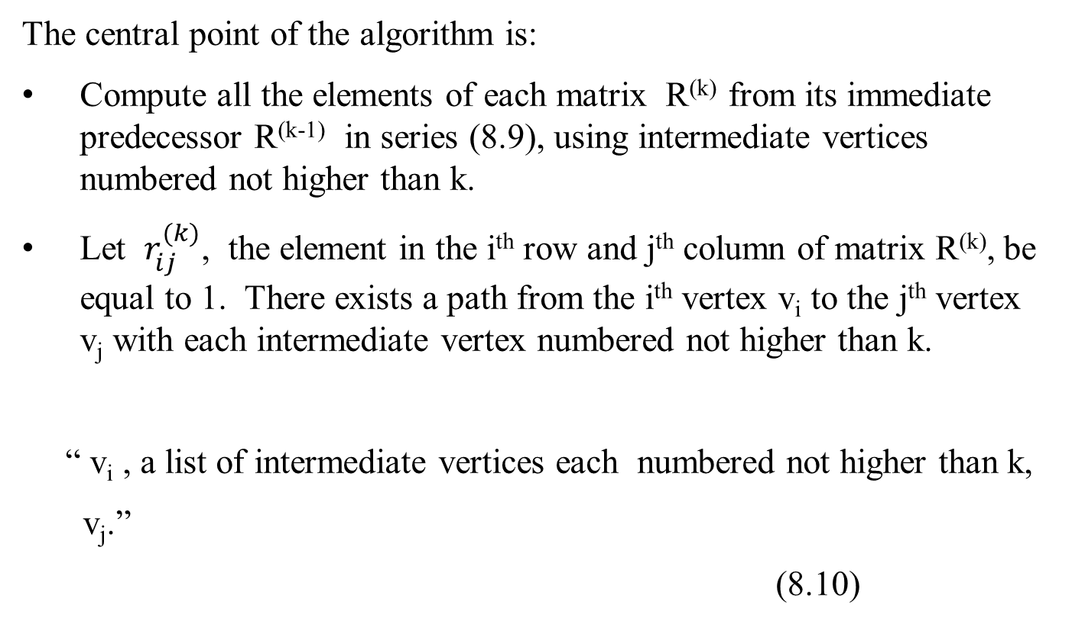
Warshall’s Algorithm
The central point of the algorithm is:
Compute all the elements of each matrix R^{(k)} from its immediate predecessor R^{(k-1)} in series (8.9), using intermediate vertices numbered not higher than k.
Let $r_{ij}^{(k)}$, the element in the i^{th} row and j^{th} column of matrix R^{(k)}, be equal to 1. There exists a path from the i^{th} vertex v_{i} to the j^{th} vertex v_{j} with each intermediate vertex numbered not higher than k.
“ v_{i} , a list of intermediate vertices each numbered not higher than k,
v_{j}.”
(8.10)

Slide 11
Warshall’s Algorithm
i k j implies that i k j
j k j k
R^{(k-1)} = k R^{(k)} = k 1
i 0 i 1 1
1
1
1
Figure 8.12 Rule for changing zeros in Warshall’s algorithm

Slide 12
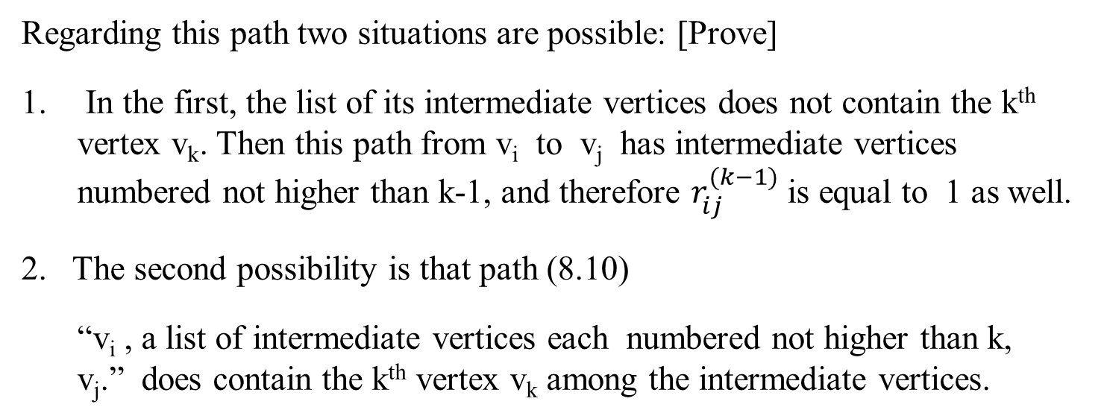
Warshall’s Algorithm
Regarding this path two situations are possible: [Prove]
In the first, the list of its intermediate vertices does not contain the k^{th} vertex v_{k}. Then this path from v_{i} to v_{j} has intermediate vertices numbered not higher than k-1, and therefore $r_{ij}^{(k−1)}$ is equal to 1 as well.
2. The second possibility is that path (8.10)
“v_{i} , a list of intermediate vertices each numbered not higher than k, v_{j}.” does contain the k^{th} vertex v_{k} among the intermediate vertices.

Slide 13
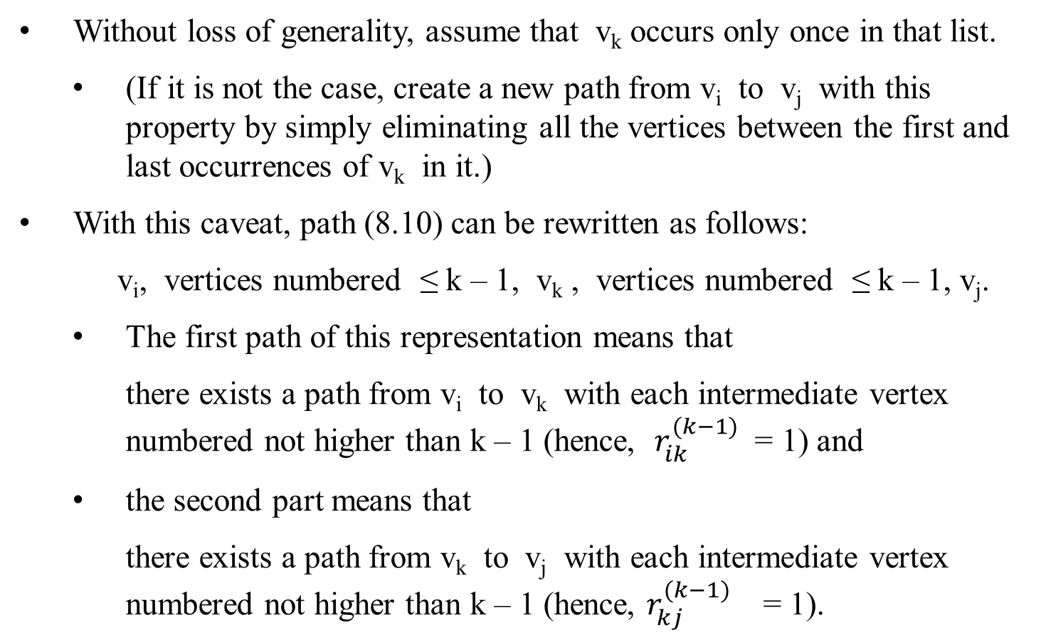
Without loss of generality, assume that v_{k} occurs only once in that list.
(If it is not the case, create a new path from v_{i} to v_{j} with this property by simply eliminating all the vertices between the first and last occurrences of v_{k} in it.)
With this caveat, path (8.10) can be rewritten as follows:
v_{i}, vertices numbered ≤ k – 1, v_{k} , vertices numbered ≤ k – 1, v_{j}.
The first path of this representation means that
there exists a path from v_{i} to v_{k} with each intermediate vertex numbered not higher than k – 1 (hence, $r_{ik}^{(k−1)}$ = 1) and
the second part means that
there exists a path from v_{k} to v_{j} with each intermediate vertex numbered not higher than k – 1 (hence, $r_{kj}^{(k−1)}$ = 1).

Slide 14
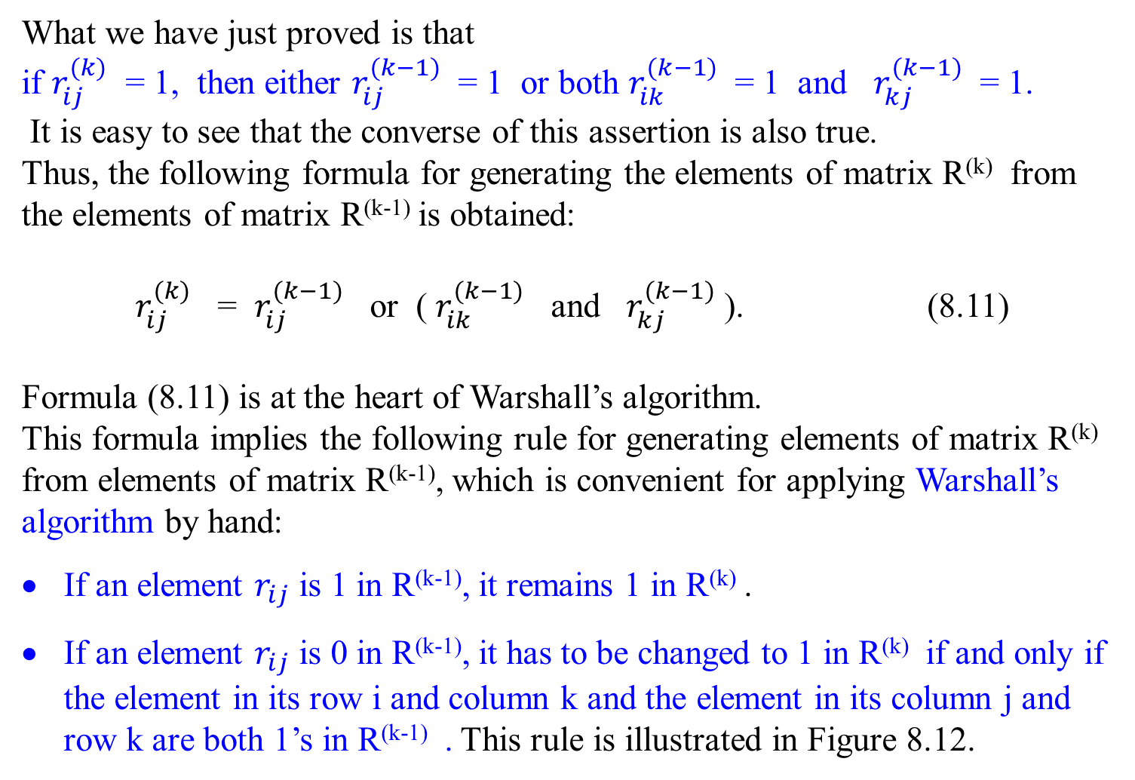
What we have just proved is that
if $r_{ij}^{(k)}$ = 1, then either $r_{ij}^{(k−1)}$ = 1 or both $r_{ik}^{(k−1)}$ = 1 and $r_{kj}^{(k−1)}$ = 1.
It is easy to see that the converse of this assertion is also true.
Thus, the following formula for generating the elements of matrix R^{(k)} from the elements of matrix R^{(k-1)} is obtained:
$r_{ij}^{(k)}$ = $r_{ij}^{(k−1)}$ or ( $r_{ik}^{(k−1)}$ and $r_{kj}^{(k−1)}$ ). (8.11)
Formula (8.11) is at the heart of Warshall’s algorithm.
This formula implies the following rule for generating elements of matrix R^{(k)} from elements of matrix R^{(k-1)}, which is convenient for applying Warshall’s algorithm by hand:
If an element $r_{ij}$ is 1 in R^{(k-1)}, it remains 1 in R^{(k)} .
If an element $r_{ij}$ is 0 in R^{(k-1)}, it has to be changed to 1 in R^{(k)} if and only if the element in its row i and column k and the element in its column j and row k are both 1’s in R^{(k-1)} . This rule is illustrated in Figure 8.12.

Slide 15
Warshall’s Algorithm
As an example, the application of Warshall’s algorithm to the diagraph of Figure 8.11 is shown in Figure 8.13.
Figure 8.13 Application of Warshall’s algorithm to the digraph shown. New 1’s are in bold.
1’s reflect the existence of paths with no intermediate vertices. (R⁽⁰⁾ is just the adjacency matrix); boxed row and column are used for getting R⁽¹⁾ .
a
b
a b c d
a 0 1 0 0
R⁽⁰⁾ = b 0 0 0 1
 | a | b | c | d
a | 0 | 1 | 0 | 0
b | 0 | 0 | 0 | 1
c | 0 | 0 | 0 | 0
d | 1 | 1 | 1 | 0
c 0 0 0 0
c
d
d 1 0 1 0
R⁽¹⁾ =
(d, a, b) (d, b)

Slide 16
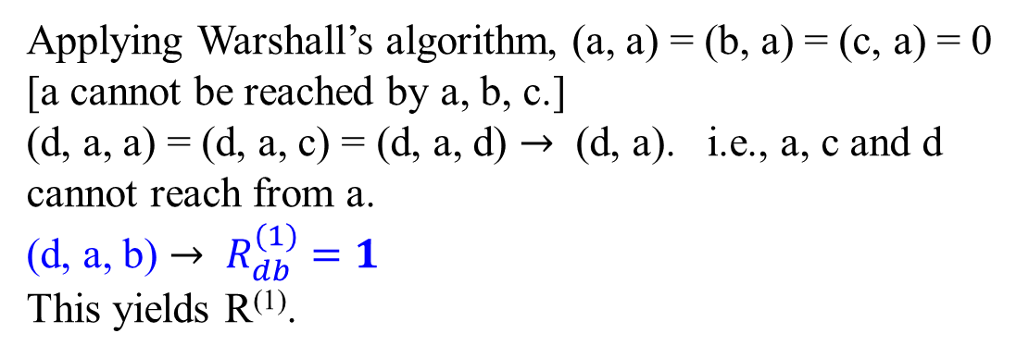
Applying Warshall’s algorithm, (a, a) = (b, a) = (c, a) = 0 [a cannot be reached by a, b, c.]
(d, a, a) = (d, a, c) = (d, a, d) $→$ (d, a). i.e., a, c and d cannot reach from a.
(d, a, b) $→$ $R_{db}^{(1)}=1$
This yields R⁽¹⁾.
a
b
c
d
1’s reflect the existence of paths
with intermediate vertices numbered not higher than 1, i.e., just vertex a (note a new path from d to b); boxed row and column are used for getting R⁽²⁾ .
a b c d
a 0 1 0 0
R⁽¹⁾ = b 0 0 0 1
c 0 0 0 0
 | a | b | c | d
a | 0 | 1 | 0 | 1
b | 0 | 0 | 0 | 1
c | 0 | 0 | 0 | 0
d | 1 | 1 | 1 | 1
d 1 1 1 0
R⁽²⁾ =
(d, b, d) (d, d)
(a, b, d) (a, d)

Slide 17
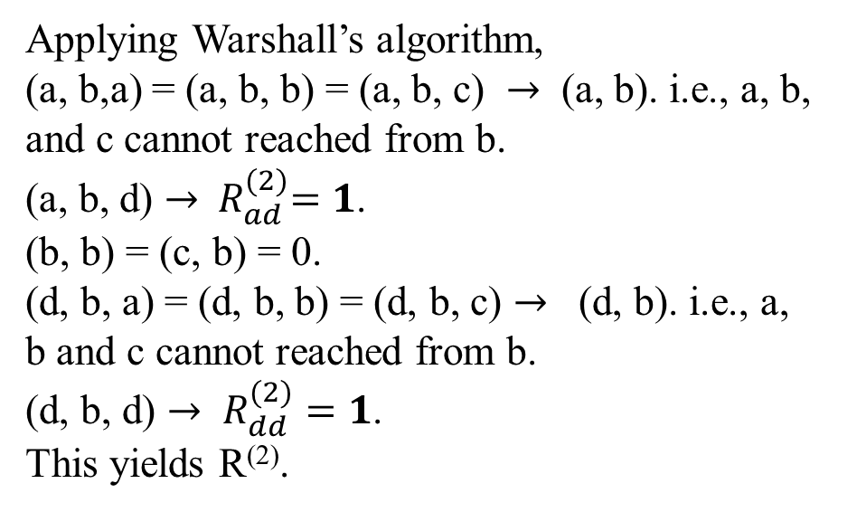
Applying Warshall’s algorithm,
(a, b,a) = (a, b, b) = (a, b, c) $→$ (a, b). i.e., a, b, and c cannot reached from b.
(a, b, d) $→{ R}_{ad}^{(2)}=1$.
(b, b) = (c, b) = 0.
(d, b, a) = (d, b, b) = (d, b, c) $→$ (d, b). i.e., a, b and c cannot reached from b.
(d, b, d) $→$ $R_{dd}^{(2)}=1$.
This yields R⁽²⁾.
a
b
c
d
1’s reflect the existence of paths
with intermediate vertices numbered
not higher than 2, i.e., a and b (note two new paths); boxed row and column are used for getting R⁽³⁾ .
a b c d
a 0 1 0 1
R⁽²⁾ = b 0 0 0 1
 | a | b | c | d
a | 0 | 1 | 0 | 1
b | 0 | 0 | 0 | 1
c | 0 | 0 | 0 | 0
d | 1 | 1 | 1 | 1
c 0 0 0 0
d 1 1 1 1
R⁽³⁾ =

Slide 18
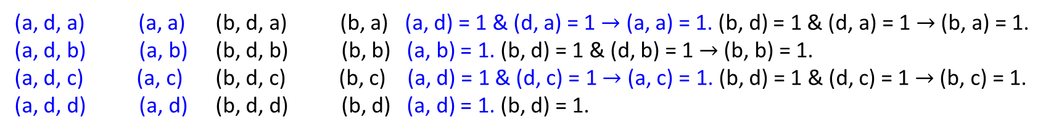
Applying Warshall’s algorithm,
(a, c) = (b, c) =(c, c)=0. i.e., c cannot be reached by a, b and c.
(d,c,a) =(d,c,b) =(d,c,c) = (d,c,d) =(d,c).
i.e., a, b, c and d cannot be reached from c.
This yields R⁽³⁾ , which has no change from R⁽²⁾ .
a
b
c
d
1’s reflect the existence of paths
with intermediate vertices numbered
not higher than 3, i.e., a, b and c
(no new paths);
boxed row and column are used for
getting R⁽⁴⁾ .
a b c d
 | a | b | c | d
a | 1 | 1 | 1 | 1
b | 1 | 1 | 1 | 1
c | 0 | 0 | 0 | 0
d | 1 | 1 | 1 | 1
a 0 1 0 1
R⁽⁴⁾ =
R⁽³⁾ = b 0 0 0 1
c 0 0 0 0
d 1 1 1 1
(a, d, a) (a, a) (b, d, a) (b, a) (a, d) = 1 & (d, a) = 1 $→$ (a, a) = 1. (b, d) = 1 & (d, a) = 1 $→$ (b, a) = 1.
(a, d, b) (a, b) (b, d, b) (b, b) (a, b) = 1. (b, d) = 1 & (d, b) = 1 $→$ (b, b) = 1.
(a, d, c) (a, c) (b, d, c) (b, c) (a, d) = 1 & (d, c) = 1 $→$ (a, c) = 1. (b, d) = 1 & (d, c) = 1 $→$ (b, c) = 1.
(a, d, d) (a, d) (b, d, d) (b, d) (a, d) = 1. (b, d) = 1.

Slide 19
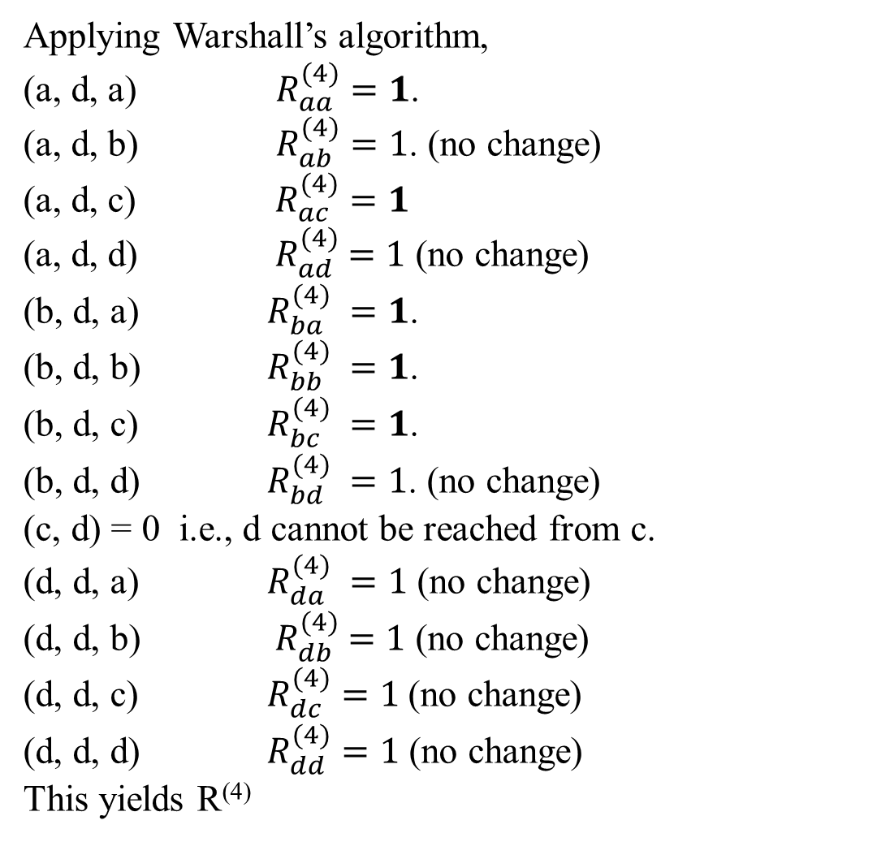
Applying Warshall’s algorithm,
(a, d, a) $R_{aa}^{(4)}=1$.
(a, d, b) $R_{ab}^{(4)}=1$. (no change)
(a, d, c) $R_{ac}^{(4)}=1$
(a, d, d) ${ R}_{ad}^{(4)} =1$ (no change)
(b, d, a) $R_{ba}^{(4)} =1$.
(b, d, b) $R_{bb}^{(4)} =1$.
(b, d, c) $R_{bc}^{(4)} =1$.
(b, d, d) $R_{bd}^{(4)} =1$. (no change)
(c, d) = 0 i.e., d cannot be reached from c.
(d, d, a) $R_{da}^{(4)} =1$ (no change)
(d, d, b) ${ R}_{db}^{(4)} =1$ (no change)
(d, d, c) $R_{dc}^{(4)}=1$(no change)
(d, d, d) $R_{dd}^{(4)}=1$ (no change)
This yields R⁽⁴⁾
a b c d
a 1 1 1 1
R⁽⁴⁾ = b 1 1 1 1
c 0 0 0 0
d 1 1 1 1
1’s reflect the existence of paths
with intermediate vertices numbered
not higher than 4, i.e., a, b, c and d
(note five new paths).
Figure 8.13 Application of Warshall’s algorithm to the digraph shown. New 1’s are in bold.

Slide 20

a
b
1’s reflect the existence of paths with no intermediate vertices. (R⁽⁰⁾ is just the adjacency matrix); boxed row and column are used for getting R⁽¹⁾ .
a b c d
a 0 1 0 0
R⁽⁰⁾ = b 0 0 0 1
c 0 0 0 0
c
d
d 1 0 1 0
$$↓$$
a b c d
1’s reflect the existence of paths with intermediate vertices numbered not higher than 4, i.e., a, b, c and d
(note five new paths).
a 1 1 1 1
R⁽⁴⁾ = b 1 1 1 1
c 0 0 0 0
d 1 1 1 1

Slide 21
Here is pseudo of Warshall’s algorithm.
Algorithm Warshall(A[1 .. n, 1 .. n])
//Implements Warshall’s algorithm for computing the transitive closure
Input: The adjacency matrix A of a digraph with n vertices
Output: The transitive closure of the digraph
R⁽⁰⁾ ← A;
for k ← 1 to n do // R^{(k)}[i, j]
for i ← 1 to n do //ith row
for j ← 1 to n do //jth column
R^{(k)}[i, j] ← R^{(k)}[i, j] or R^{(k-1)}[i, k] and R^{(k-1)}[k, j]
// R^{(k)}[i, j] will be assigned 1 depending on
// either R^{(k)}[i, j] = 1 or [R^{(k-1)}[i, k] and R^{(k-1)}[k, j]] = 1
return R^{(n)}

Slide 22
Warshall’s Algorithm
i k j implies that i k j
j k j k
R^{(k-1)} = k R^{(k)} = k 1
i 0 i 1 1
1
1
1
Figure 8.12 Rule for changing zeros in Warshall’s algorithm

Slide 23
Demonstration: Consider the above adjacency matrix using a = 1, b= 2, c= 3 and d = 4.
R⁽⁰⁾ ← A;
for k ← 1 to n do
for i ← 1 to n do
for j ← 1 to n do
R^{(k)}[i, j] ← R^{(k-1)}[i, j] or R^{(k-1)}[i, k] and R^{(k-1)}[k, j]
a b c d
1’s reflect the existence of paths with no intermediate vertices. (R⁽⁰⁾ is just the adjacency matrix); boxed row and column are used for getting R⁽¹⁾ .
a 0 1 0 0
R⁽⁰⁾ = b 0 0 0 1
c 0 0 0 0
d 1 0 1 0
Define (i, k, j) to be (i_{row}, k_{column}) and (k_{row}, j_{column}).
(d, a, b) $→$ (d, b), others (d, a, a), (d, a, c), (d, a, d) are unreachable, for (a, a), (a, c) and (a, d) are not reachable.

Slide 24
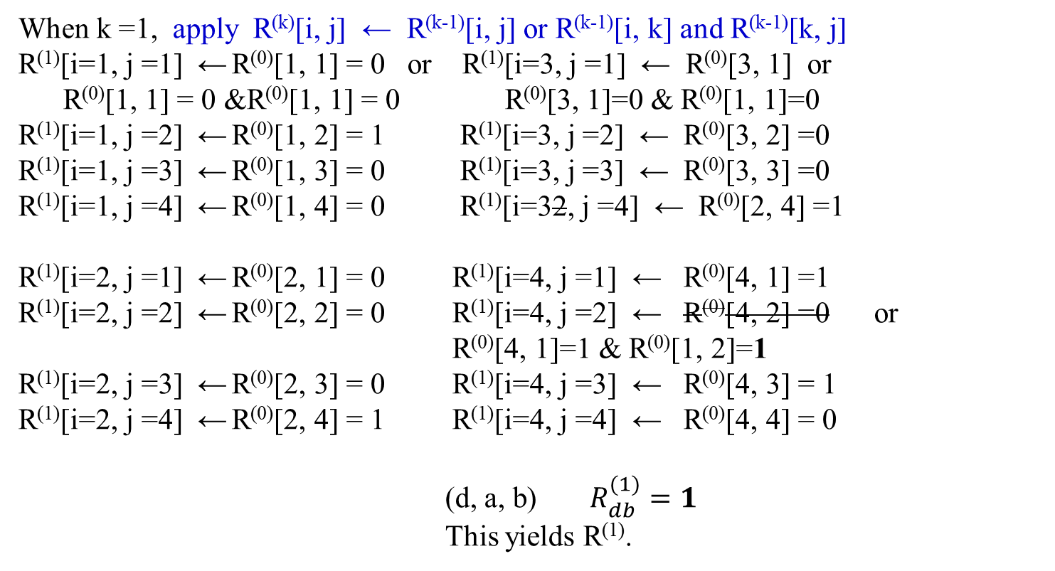
When k =1, apply R^{(k)}[i, j] ← R^{(k-1)}[i, j] or R^{(k-1)}[i, k] and R^{(k-1)}[k, j]
R⁽¹⁾[i=1, j =1] ← R⁽⁰⁾[1, 1] = 0 or R⁽¹⁾[i=3, j =1] ← R⁽⁰⁾[3, 1] or
R⁽⁰⁾[1, 1] = 0 &R⁽⁰⁾[1, 1] = 0 R⁽⁰⁾[3, 1]=0 & R⁽⁰⁾[1, 1]=0
R⁽¹⁾[i=1, j =2] ← R⁽⁰⁾[1, 2] = 1 R⁽¹⁾[i=3, j =2] ← R⁽⁰⁾[3, 2] =0
R⁽¹⁾[i=1, j =3] ← R⁽⁰⁾[1, 3] = 0 R⁽¹⁾[i=3, j =3] ← R⁽⁰⁾[3, 3] =0
R⁽¹⁾[i=1, j =4] ← R⁽⁰⁾[1, 4] = 0 R⁽¹⁾[i=32, j =4] ← R⁽⁰⁾[2, 4] =1
R⁽¹⁾[i=2, j =1] ← R⁽⁰⁾[2, 1] = 0 R⁽¹⁾[i=4, j =1] ← R⁽⁰⁾[4, 1] =1
R⁽¹⁾[i=2, j =2] ← R⁽⁰⁾[2, 2] = 0 R⁽¹⁾[i=4, j =2] ← R⁽⁰⁾[4, 2] =0 or
R⁽⁰⁾[4, 1]=1 & R⁽⁰⁾[1, 2]=1
R⁽¹⁾[i=2, j =3] ← R⁽⁰⁾[2, 3] = 0 R⁽¹⁾[i=4, j =3] ← R⁽⁰⁾[4, 3] = 1
R⁽¹⁾[i=2, j =4] ← R⁽⁰⁾[2, 4] = 1 R⁽¹⁾[i=4, j =4] ← R⁽⁰⁾[4, 4] = 0
(d, a, b) $R_{db}^{(1)}=1$
This yields R⁽¹⁾.

Slide 25
a
b
c
d
a b c d
1’s reflect the existence of paths
with intermediate vertices numbered
not higher than 1, i.e., just vertex a
(note a new path from d to b);
boxed row and column are used for
getting R⁽²⁾ .
a 0 1 0 0
R⁽¹⁾ = b 0 0 0 1
c 0 0 0 0
d 1 1 1 0

Slide 26
When k =2, apply R^{(k)}[i, j] ← R^{(k-1)}[i, j] or R^{(k-1)}[i, k] and R^{(k-1)}[k, j]
R⁽²⁾[i=1, j =1] ← R⁽¹⁾[1, 1] = 0 R⁽²⁾[i=3, j =1] ← R⁽¹⁾[3, 1]
R⁽²⁾[i=1, j =2] ← R⁽¹⁾[1, 2] = 1 R⁽²⁾[i=3, j =2] ← R⁽¹⁾[3, 2] = 0
R⁽²⁾[i=1, j =3] ← R⁽¹⁾[1, 3] = 0 R⁽²⁾[i=3, j =3] ← R⁽¹⁾[3, 3] = 0
R⁽²⁾[i=1, j =4] ← R⁽¹⁾[1, 4] =0 or R⁽²⁾[i=2, j =4] ← R⁽¹⁾[2, 4] = 1
R⁽¹⁾[1, 2]=1 & R⁽¹⁾[2, 4]=1 R⁽¹⁾[2, 2]=0 &R⁽¹⁾[2, 4] = 1
R⁽²⁾[i=2, j =1] ← R⁽¹⁾[2, 1] = 0 R⁽²⁾[i=4, j =1] ← R⁽¹⁾[4, 1] = 1
R⁽²⁾[i=2, j =2] ← R⁽¹⁾[2, 2] = 0 or R⁽²⁾[i=4, j =2] ← R⁽¹⁾[4, 2] = 1 or
R⁽¹⁾[2, 2]=0 R⁽¹⁾[2, 2]=0 R⁽¹⁾[4, 2]=1 & R⁽¹⁾[2, 2]=0
R⁽²⁾[i=2, j =3] ← R⁽¹⁾[2, 3] = 0 R⁽²⁾[i=4, j =3] ← R⁽¹⁾[4, 3] = 1
R⁽²⁾[i=2, j =4] ← R⁽¹⁾[2, 4] = 1 R⁽²⁾[i=4, j =4] ← R⁽¹⁾[4, 4] = 0 or
R⁽¹⁾[4, 2] = 1 & R⁽¹⁾[2, 4] =1

Slide 27
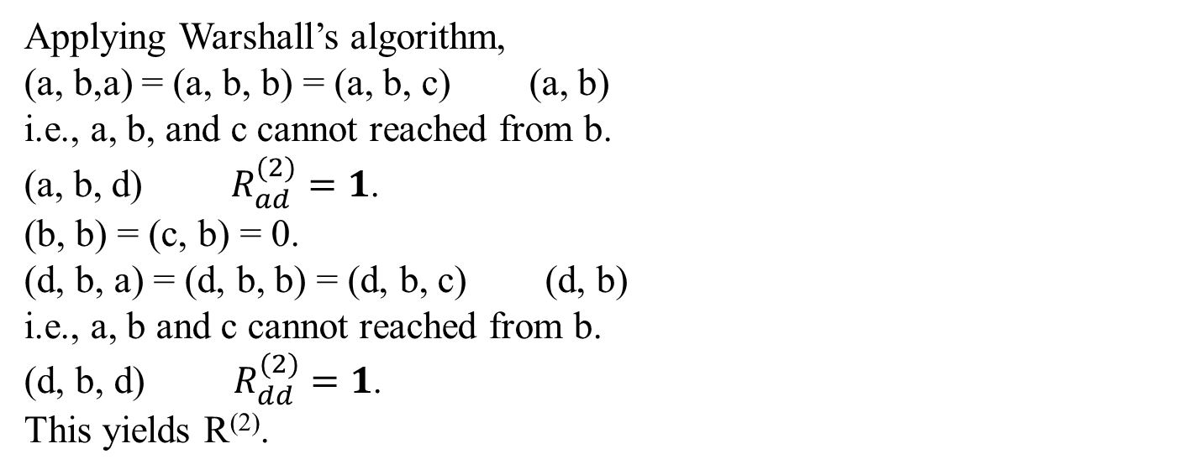
Applying Warshall’s algorithm,
(a, b,a) = (a, b, b) = (a, b, c) (a, b)
i.e., a, b, and c cannot reached from b.
(a, b, d) $R_{ad}^{(2)}=1$.
(b, b) = (c, b) = 0.
(d, b, a) = (d, b, b) = (d, b, c) (d, b)
i.e., a, b and c cannot reached from b.
(d, b, d) $R_{dd}^{(2)}=1$.
This yields R⁽²⁾.

Slide 28
a b c d
1’s reflect the existence of paths
with intermediate vertices numbered
not higher than 2, i.e., a and b
(note two new paths);
boxed row and column are used for
getting R⁽³⁾ .
a 0 1 0 1
R⁽²⁾ = b 0 0 0 1
c 0 0 0 0
d 1 1 1 1
a
b
c
d

Slide 29
When k =3, apply R^{(k)}[i, j] ← R^{(k-1)}[i, j] or R^{(k-1)}[i, k] and R^{(k-1)}[k, j]
R⁽³⁾[i=1, j =1] ← R⁽²⁾[1, 1] = 0 R⁽³⁾[i=3, j =1] ← R⁽²⁾[3, 1] = 0
R⁽³⁾[i=1, j =2] ← R⁽²⁾[1, 2] = 1 R⁽³⁾[i=3, j =2] ← R⁽²⁾[3, 2] = 0
R⁽³⁾[i=1, j =3] ← R⁽²⁾[1, 3] = 0 R⁽³⁾[i=3, j =3] ← R⁽²⁾[3, 3] = 0
R⁽³⁾[i=1, j =4] ← R⁽²⁾[1, 4] = 1 or R⁽³⁾[i=2, j =4] ← R⁽²⁾[2, 4] = 1 or
R⁽²⁾[1, 3]=0 & R⁽²⁾[3, 4]=0 R⁽²⁾[2, 3]=0 & R⁽²⁾[3, 4] = 0
R⁽³⁾[i=2, j =1] ← R⁽²⁾[2, 1] = 0 R⁽³⁾[i=4, j =1] ← R⁽²⁾[4, 1] = 1
R⁽³⁾[i=2, j =2] ← R⁽²⁾[2, 2] = 0 or R⁽³⁾[i=4, j =2] ← R⁽²⁾[4, 2] = 1 or
R⁽²⁾[2, 3]=0 R⁽²⁾[3, 2]=0 R⁽²⁾[4, 3]=1 & R⁽²⁾[3, 2]=0
R⁽³⁾[i=2, j =3] ← R⁽²⁾[2, 3] = 0 R⁽³⁾[i=4, j =3] ← R⁽²⁾[4, 3] = 1
R⁽³⁾[i=2, j =4] ← R⁽²⁾[2, 4] = 1 R⁽³⁾[i=4, j =4] ← R⁽²⁾[4, 4] = 1 or
R⁽²⁾[4, 3] = 1 & R⁽²⁾[3, 4] = 0
Applying Warshall’s algorithm,
(a, c) = (b, c) =(c, c)=0. i.e., c cannot be reached by a, b and c.
(d,c,a) =(d,c,b) =(d,c,c) = (d,c,d) =(d,c) i.e., a, b, c and d cannot be reached from c.
This yields R⁽³⁾ , which has no change from R⁽²⁾ .

Slide 30
a
b
c
d
a b c d
1’s reflect the existence of paths
with intermediate vertices numbered
not higher than 3, i.e., a, b and c
(no new paths);
boxed row and column are used for
getting R⁽⁴⁾ .
a 0 1 0 1
R⁽³⁾ = b 0 0 0 1
c 0 0 0 0
d 1 1 1 1

Slide 31
When k =4, apply R^{(k)}[i, j] ← R^{(k-1)}[i, j] or R^{(k-1)}[i, k] and R^{(k-1)}[k, j]
R⁽⁴⁾[i=1, j =1] ← R⁽³⁾[1, 1] = 0 or R⁽⁴⁾[i=3, j =1] ← R⁽³⁾[3, 1] = 0 or
R⁽³⁾[1, 4]=1 & R⁽³⁾[4, 1]=1 R⁽³⁾[3, 4]=0 & R⁽³⁾[4, 1]=1
R⁽⁴⁾[i=1, j =2] ← R⁽³⁾[1, 2] = 1 R⁽⁴⁾[i=3, j =2] ← R⁽³⁾[3, 2] = 0 or
R⁽³⁾[3, 4]=0 & R⁽³⁾[4, 2]=1
R⁽⁴⁾[i=1, j =3] ← R⁽³⁾[1, 3]=0 or R⁽⁴⁾[i=3, j =3] ← R⁽³⁾[3, 3]=0
R⁽³⁾[1, 4]=1 & R⁽³⁾[4, 3]=1 R⁽³⁾[3, 4]=0 & R⁽³⁾[4, 3]=1
R⁽⁴⁾[i=1, j =4] ← R⁽²⁾[1, 4] =1 or R⁽⁴⁾[i=3, j =4] ← R⁽³⁾[3, 4] = 0 or
R⁽³⁾[1, 4]=1 & R⁽³⁾[4, 4]=1 R⁽³⁾[3, 4]=0 & R⁽³⁾[4, 4]=1
R⁽⁴⁾[i=2, j =1] ← R⁽³⁾[2, 1] =0 R⁽⁴⁾[i=4, j =1] ← R⁽³⁾[4, 1] = 1 or
R⁽³⁾[2, 4]=1 & R⁽³⁾[4, 1]=1 R⁽³⁾[4, 4]=1 & R⁽³⁾[4, 1]=1
R⁽⁴⁾[i=2, j =2] ← R⁽³⁾[2, 2] = 0 or R⁽⁴⁾[i=4, j =2] ← R⁽³⁾[4, 2] = 1 or
R⁽³⁾[2, 4]=1 R⁽³⁾[4, 2]=1 R⁽³⁾[4, 4]=1 & R⁽³⁾[4, 2]=1
R⁽⁴⁾[i=2, j =3] ← R⁽³⁾[2, 3] = 0 or R⁽⁴⁾[i=4, j =3] ← R⁽³⁾[4, 3] = 1
R⁽³⁾[2, 4]=1 & R⁽³⁾[4, 3]=1 R⁽³⁾[4, 4]=1 & R⁽³⁾[4, 3]=1
R⁽⁴⁾[i=2, j =4] ← R⁽³⁾[2, 4] = 1 R⁽⁴⁾[i=4, j =4] ← R⁽³⁾[4, 4] = 1 or
R⁽³⁾[2, 4]=1 & R⁽³⁾[4, 4]=1 R⁽³⁾[4, 4]=1 & R⁽³⁾[4, 4]=1

Slide 32

Applying Warshall’s algorithm,
(a, d, a) $R_{aa}^{(4)}=1$.
(a, d, b) $R_{ab}^{(4)}=1$. (no change)
(a, d, c) $R_{ac}^{(4)}=1$
(a, d, d) ${ R}_{ad}^{(4)}=1$ (no change)
(b, d, a) $R_{ba}^{(4)}=1$.
(b, d, b) $R_{bb}^{(4)}=1$.
(b, d, c) $R_{bc}^{(4)}=1$.
(b, d, d) $R_{bd}^{(4)}=1$. (no change)
(c, d) = 0
i.e., d cannot be reached from c.
(d, d, a) $R_{da}^{(4)}=1$ (no change)
(d, d, b) $R_{db}^{(4)}=1$ (no change)
(d, d, c) $R_{dc}^{(4)}=1$(no change)
(d, d, d) $R_{dd}^{(4)}=1$ (no change)
This yields R⁽⁴⁾

Slide 33
a b c d
a 1 1 1 1
1’s reflect the existence of paths
with intermediate vertices numbered
not higher than 4, i.e., a, b, c and d
(note five new paths).
R⁽⁴⁾ = b 1 1 1 1
c 0 0 0 0
d 1 1 1 1
a
b
c
d

Slide 34
Algorithm Warshall(A[1 .. n, 1 .. n])
//Implements Warshall’s algorithm for computing the transitive closure
Input: The adjacency matrix A of a digraph with n vertices
Output: The transitive closure of the digraph
R⁽⁰⁾ ← A;
for k ← 1 to n do // R^{(k)}[i, j]
for i ← 1 to n do //ith row
for j ← 1 to n do //jth column
R^{(k)}[i, j] ← R^{(k)}[i, j] or R^{(k-1)}[i, k] and R^{(k-1)}[k, j]
// R^{(k)}[i, j] will be assigned 1 depending on
// either R^{(k)}[i, j] = 1 or [R^{(k-1)}[i, k] and R^{(k-1)}[k, j]] = 1
return R^{(n)}

Slide 35
Several observations need to be made about Warshall’s algorithm.
It is remarkably succinct.
Its time efficiency is ϴ(n³).
For sparse graphs represented by their adjacency lists, the traversal-based algorithm has a better asymptotic efficiency than Warshall’s algorithm (why?) For n vertices, the time efficiency for using DFS is n* ϴ(|E|+|V|).
Speed up the implementation of Warshall’s algorithm for some inputs by restructuring its innermost loop.
The algorithm could run faster if treat matrix rows as bit strings and employ the bitwise or operation available in most modern computer languages.

Slide 36
The space efficiency of Warshall’s algorithm:
It is similar to that of computing a Fibonacci number and computing a binomial coefficient, and some other dyanamic programming algorithms.
It is unnecessary to use separate matrices for recording intermediate results of the algorithm.
The goodness of Warshall’s algorithm:
The underlying idea of Warshall’s algorithm can be applied to the more general problem of finding lengths of shortest paths in weighted graphs.

Slide 37
Floyd’s Algorithm : Chapter 06_04
for the All-Pairs Shortest-Paths Problem

Slide 38

Floyd’s Algorithm for the All-Pairs Shortest-Paths Problem
Given a weighted connected graph (undirected or directed), the all-pairs shortest-paths problem asks to find the distances – i.e., the lengths of the shortest paths – from each vertex to all other vertices.
This is one of several variations of the problem involving shortest paths in graphs.
It is important applications to communications, transportation networks, and operations research. Among recent applications of all-pairs shortest-path problem is precomputing distances for motion planning in computer games.
We use the distance matrix: the element d_{ij} in the ith row and the jth column to indicate the length of the shortest path from the ith vertex to the jth vertex. Figure 8.14 is an example.

Slide 39
a b c d
a 0 ∞ 3 ∞
W = b 2 0 ∞ ∞
c ∞ 7 0 1
d 6 ∞ ∞ 0
a
2
b
(b) Its weight matrix
3 6 7
a b c d
a 0 10 3 4
T = b 2 0 5 6
c 7 7 0 1
d 6 16 9 0
c
d
1
Digraph
(c) Its distance matrix
Figure 8.14 (a) Digraph. (b) Its weight matrix. (c) Its distance matrix.

Slide 40
Chapter 06_04
Dynamic Programming
Floyd’s Algorithm for Shortest-Paths

